Slide 1

The Choice of Trigger in an Insurance Linked Security: the Mortality Risk Case
by
Richard MacMinn and Andreas Richter
2011 China International Conference on Insurance and Risk Management
Beijing, July 2011

Slide 2
Agenda
Introduction
Model
Results
  Limited liability
  Indemnity versus index triggers
  Incentive effects of hedging
Conclusions

Slide 3
Introduction
In December 2003, Swiss Re introduced the first insurance-linked security (ILS) relating to life-insurance risk
Hedge for excessive brevity risk
Designed to cover correlated mortality surprises such as pandemics
Potential for excessive longevity hedges as well (correlated risks resulting from mortality improvements due to genetics etc.)
Structure similar to CAT bonds

Slide 4
Introduction

Slide 5
Introduction

Slide 6
Introduction

Slide 7
Introduction: related literature
Securitization versus traditional reinsurance
  Introduction:
    Doherty (JACF 1997),
    Croson and Kunreuther (JRF 2000)
  Key issues: reinsurance default risk, transaction cost, moral hazard versus basis risk
  Insurance economics modeling approaches:
    Doherty and Mahul (Working Paper 2001)
    Doherty and Richter (JRI 2002)
    Nell and Richter (GPRI 2004)
Incentive distortions because of limited liability, “Judgment Proof Problem”
  Shavell (IRLE 1986), MacMinn (GPRI 2002)
  MacMinn (JRI 1987) (2005)

Slide 8
Introduction: related literature
Doherty, N. A. (1997). "Financial Innovation in the Management of Catastrophe Risk." Journal of Applied Corporate Finance 10(3): 84-95.
Croson, D. C. and H. C. Kunreuther (2000). "Customizing Indemnity Contracts and Indexed Cat Bonds for Natural Hazard Risks." Journal of Risk Finance 1(3): 24-41.
Doherty, N. A. and O. Mahul (2001). Mickey Mouse and Moral Hazard: Uninformative but Correlated Triggers. Working Paper. Wharton School.
Doherty, N. A. and A. Richter (2002). "Moral Hazard, Basis Risk and Gap Insurance." Journal of Risk and Insurance 69(1): 9-24.
Richter, A. (2003). Catastrophe Risk Management - Implications of Default Risk and Basis Risk. Working Paper. Illinois State University.
MacMinn, R. D. (1987). "Insurance and Corporate Risk Management." Journal of Risk and Insurance 54(4): 658-77.
MacMinn, R. (2005). The Fisher Model and Financial Markets. World Scientific

Slide 9
Introduction: scope of the article
Shareholder value maximizing reinsurer
Effort determines underwriting results
Reinsurer is subject to insolvency risk
  judgment proof/underinvestment problem
ILS based on actual losses vs. index
  moral hazard vs. basis risk
What are the incentive effects of ILS?
Can ILS create shareholder value?

Slide 10
Model
In the absence of any ILS, the reinsurer’s stock market value is the value of its book of business:
Ω = (0, ζ) set of states of nature ω
Π(α, ω) = Γ(ω) − L(a, ω) − a
Γ(ω) premium income
L(a, ω) loss on book of business
a (cost of) underwriting effort
p(ω) basis stock price,

Slide 11
Model
Assumption
The reinsurer’s payoff P(a, w) satisfies the Principle of Decreasing Uncertainty (PDU):
After compensating for the change in the mean, the PDU provides a decrease in the risk in the Rothschild-Stiglitz sense (MacMinn and Holtmann 1983).

Slide 12
Limited liability and incentives
The effort taken by the unhedged reinsurer, a^{u}, is determined by maximizing the stock value
  where δ is defined by Π(a, δ) = 0
The socially efficient level of effort, a^{e}, is determined by maximizing

Slide 13
Limited liability and incentives
Judgment Proof Problem
  (Shavell 1986, Kahan 1989, MacMinn 2002)
If δ > 0 then the level of care selected by the unhedged reinsurer is less than the socially efficient level, i.e., a^{u} < a^{e}, since

Slide 14
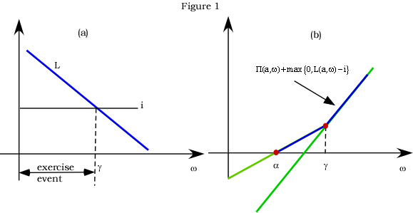
Indemnity hedge
Notes:
Suppose that α < g

Slide 15
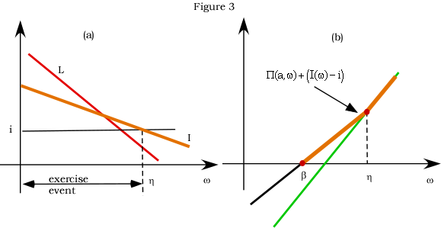
Index hedge

Slide 16
Incentive effects of hedging
Can hedging correct the adverse incentive due to the judgment proof problem?
With the hedge in place, the organization maximizes stock value now. This determines the underwriting effort a(i)
An indemnity hedge creates a moral hazard problem
An index hedge creates basis risk no but no moral hazard problem

Slide 17
Indemnity trigger
Let a^{m}(i) be the effort that maximizes S^{m}(a, i).
The function a^{m}(i) has the following characteristics:
where i* is the trigger such that a = 0 and i hat is the trigger level such that a = d

Slide 18
Altered incentives with hedging: the indemnity trigger
With indemnity based hedging . . .
  The reaction function increases in i, i.e., the more protection the lower the effort
  Incentives are completely eliminated if the trigger is sufficiently low.
  The incentive problem is aggravated.

Slide 19
Index trigger
Let a^{b}(i) be the effort that maximizes S^{b}(a, i) for a given i. Assume that I is less risky than L. Let i bar be the trigger level such that b = d
The function a^{b}(i) has the following characteristics:
If an i* exists then a^{b}(i) = a^{e} for i < i*

Slide 20
Altered incentives with hedging: the index trigger
In the index linked hedge . . .
  under certain assumptions regarding basis risk, the effort function decreases in i, i.e., the more protection the greater the effort.
  if an i* exists, such that bankruptcy risk can be entirely avoided through the hedge, even the first-best optimum is reached, i.e., a(i) = a^{e} for i < i*

Slide 21
Dominance
The index trigger instrument dominates the indemnity trigger instrument.

Slide 22
Conclusions
Insolvency risk and limited liability reduces underwriting effort
  underinvestment / judgment proof problem
  Shareholder value maximization versus other stakeholders’ interests
How does hedging affect incentives?
  An indemnity hedge reduces the underwriting effort.
  An index hedge can improve incentives.
If the index hedge can eliminate insolvency risk, it induces the first-best-optimum.

Slide 23
Future research
Model the shareholder value indirectly created by an ILS
  Hedging as a signal that decreases capital cost
  How does hedging affect incentives with respect to investment decisions?
Longevity risk

